Slide 1
IoT Project-Temperature and Humidity monitoring with Node-MCU and displaying results on webpage and in Android mobile app.
20/June/2020
Presentation- 2

Slide 2
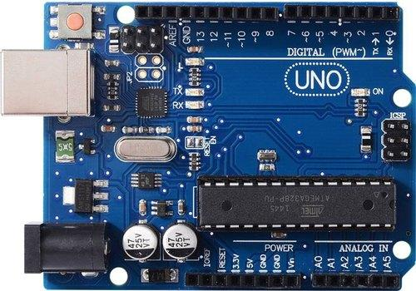
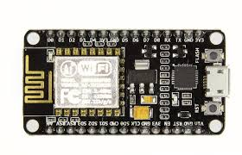
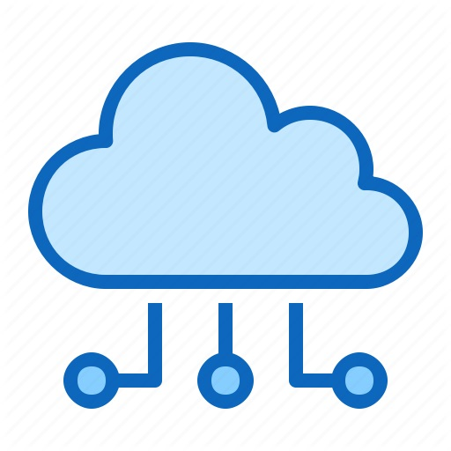
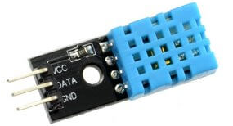
Sending data to the cloud from the Microcontroller(s)
Temperature and Humidity Data from the DHT11 sensor is collected by the Arduino Uno
This data is then sent to the NodeMCU as serial data from the Arduino Uno.
The NodeMCU connects to the internet, then sends the temperature and humidity data to the Google Firebase database.
This database will work as the location database from which the information is retrieved for our website.

Slide 3
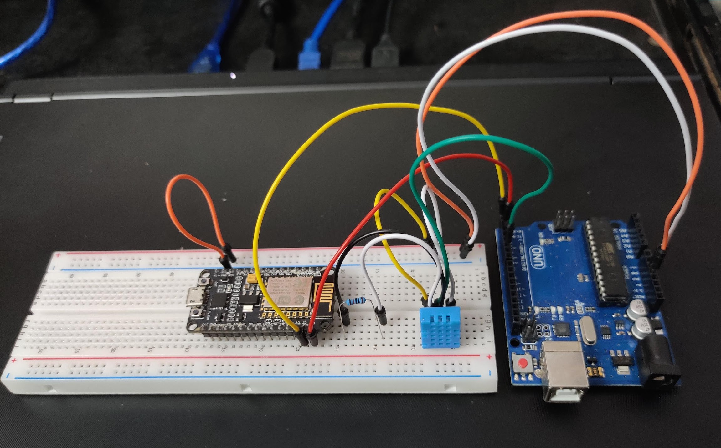
Sending data to the cloud from the Microcontroller(s)
A standalone Wi-Fi module was tried to be used with the Arduino Uno, but later it was decided to use a NodeMCU along with an Arduino Uno.
The NodeMCU must be preferably be powered from an external source independent of the Arduino Uno due to power constraints.
Two pins from the Arduino Uno are connected to two pins on the NodeMCU which are used for TX and RX operations, i.e. transferring serial data and receiving serial data.

Slide 4
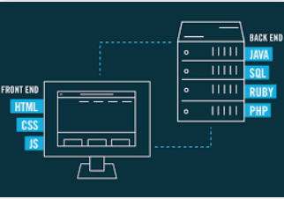

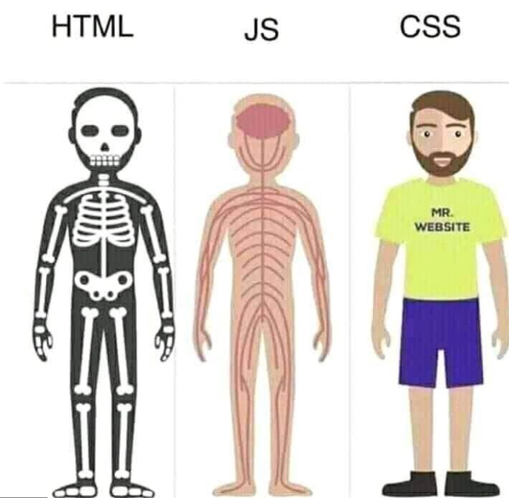



Web Development
The webpage depends on two parts:
Front end development : Front-end web development,
also known as client-side development .
Back end development : The server and the database
together form the backend of the Web Application.
HTML(Hyper Text Markup Language) : HTML provides the basic structure of sites, which is enhanced and modified by other technologies like CSS and JavaScript.
CSS(Cascading Style Sheets) : CSS is used to control presentation, formatting, and layout.
Java script: JavaScript is used to control the behavior of different elements.

Slide 5
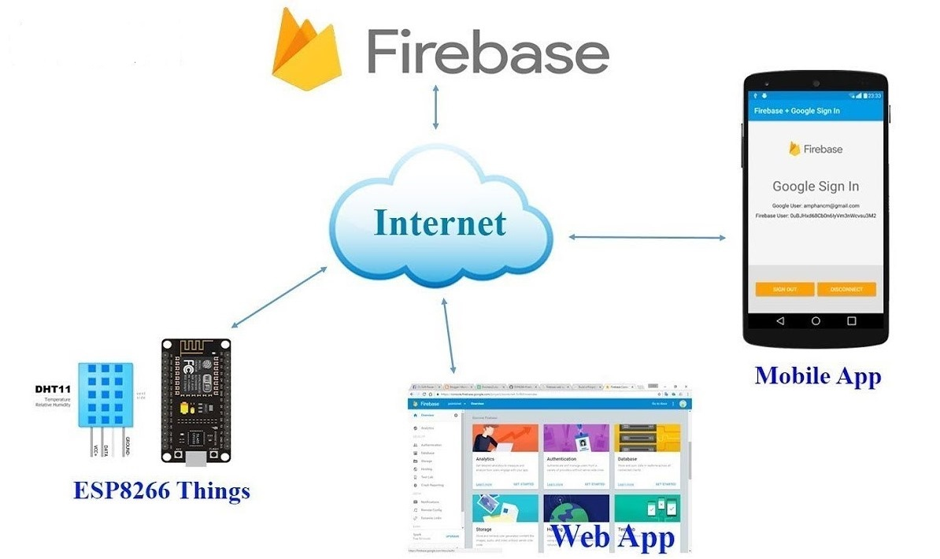
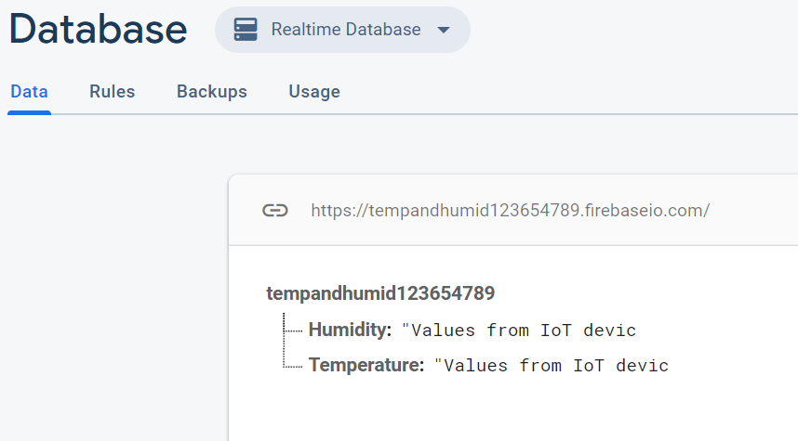
Web page to display the sensor readings.
Connected web client requests Firebase Database for the snapshots of the readings.
JavaScript appends the HTML elements of the web page upon receiving the snapshots.
Firebase libraries are used to target the specific child element in the database.
On( ) method reads real time readings by asynchronously listening to the changes.
Infinite loop creates new HTML elements to store & display readings after every 2 seconds.
Once( ) method gets triggered only once for an event to store the corresponding readings.
The website can be accessed using this link.
Firebase Console
Real time display panel.

Slide 6
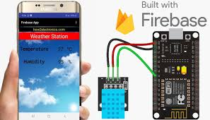
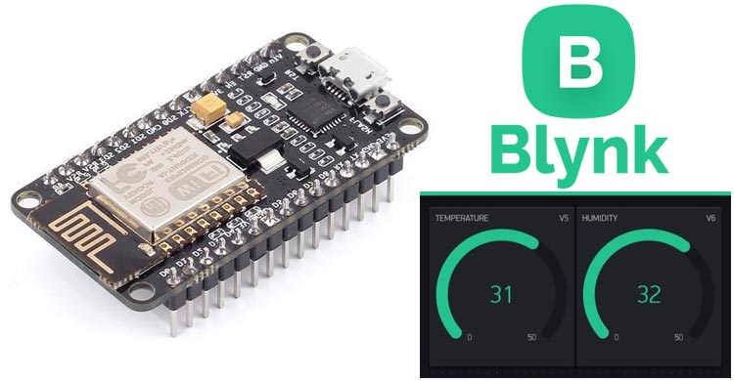
App Development
The application retrieves the data from the database and
displays it on the mobile phone.
The the mobile application play the role of a client
which interacts with the database server.
Firebase works as the Database at the backend of the
app.
Android Studio is used to link the Firebase database
with the UI of the application.
We also tried to implement the functionality
with an existing app - Blynk to display
temperature and humidity.
The main limitation for this app is that it only
works for a local area network.

Slide 7
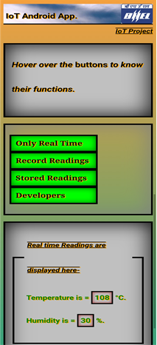
Android app to Display Results
Our android app has four functionalities which can be performed by pressing these 4 buttons as shown is the figure.
Our android app is based on the same concept of web page.
It is because we have extracted data from web page using its URL. Data is not extracted directly from our firebase server.
Our App uses internet connection of that android device and establish a connection to the web page and displays the result.
Advantage: We can store temperature and humidity data while keeping the app running in background.

Slide 8
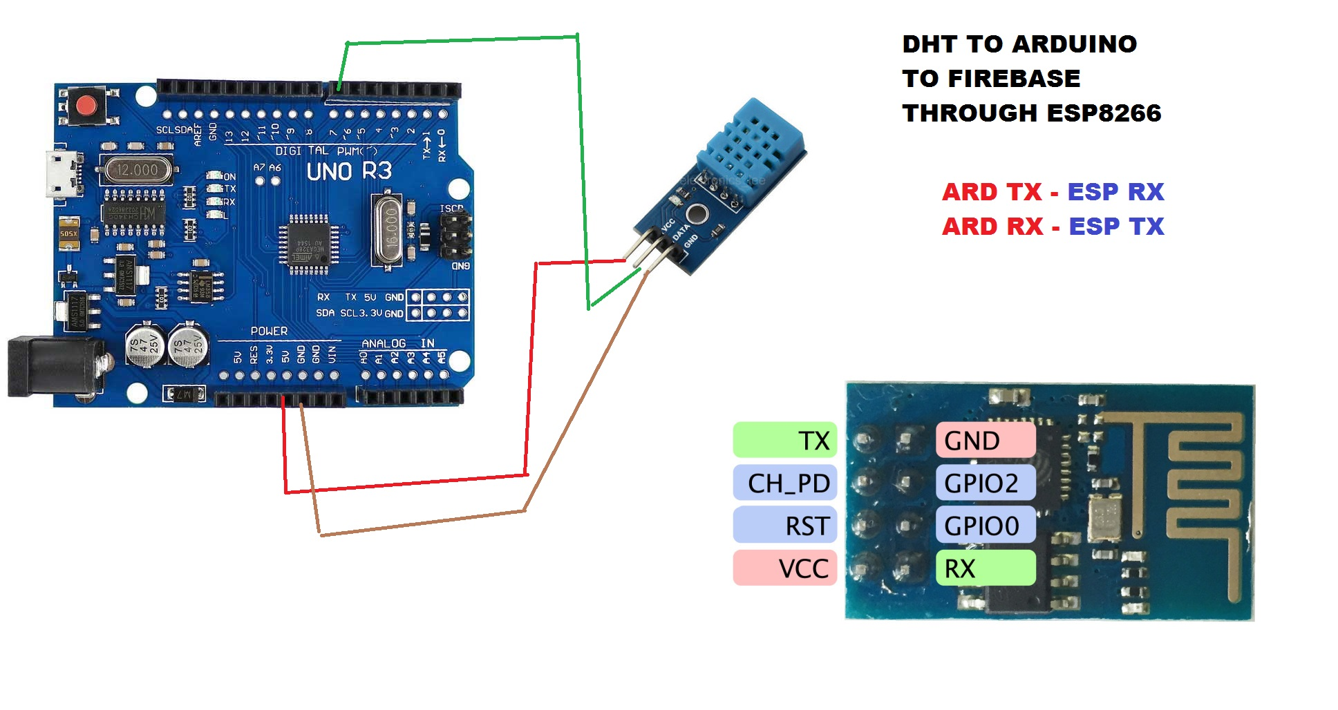
Conclusion
Setting up the Hardware (Before Midsem..)
Connecting Arduino Uno Board with a
DHT11 sensor and NodeMCU. So that the
DHT11 sensor takes the data (temperature
and humidity) as input and via the setup
sends it to the cloud.
Sending data to the cloud
Serial data is sent to NodeMCU from Arduino Uno.
NodeMCU sends this data to Google Firebase Database.
The Firebase Realtime Database is a cloud-hosted database. Data is stored as JSON and synchronized in realtime to every connected client.

Slide 9
Continue..
Development of a web-page
We developed a web-page to show our data using HTML, CSS and JavaScript.
Displaying Sensor Readings
Requests is being made to Firebase Database for the snapshot of readings.
Then our JavaScript code appends in the HTML elements of the web-page.
Firebase Libraries have made our work very easy.
App Development
Our App requests data from our website which in turn requests data from the database (Firebase) and so it plays a role of a client. (based on same concept as that of a web-page)
Linking of the Firebase database with the UI of our App is being done by Android Studio (We also tried Blynk - an existing app to display the data ).
Our App uses an internet connection to extract data from webpage using its URL and so unlike Blynk it can work from anywhere.

Slide 10
Team members
Akshay Anand (2018B5A80274H)
Chaitanya Kulkarni (2018A7PS0161P)
Chaitanya Vyas (2018B4A80831P)
Kartik Vinod Jhawar (2018B1A80654P)
Paras Taneja (2018B2A80999P)
Saketh Kalaga (2018B5A80929P)

Slide 11
Thank You!

